Slide 1
Hackathon
Group 5
Asher Lopes (Group Leader)
Amey Bagwe
Oswin Lopes

Slide 2
Introduction :
Problem statement : Researchers Platform
The goal is to create an online based research platform for students/researchers/industry experts etc.
The user will have the facility to create a research paper and can request for collaboration with the other users for implementation of a paper
A user can request for papers and the users with whom they’d like to collaborate
A section where the user can guide other users for their papers.
Mentors will have the facility to put their areas of expertise and accordingly a mentor would be selected for guidance
A conference section where the papers can be presented for publication

Slide 3
Problem Statement :
This project is aimed at designing an all in one platform for users who wish to create and collaborate for a certain research papers
Users can get mentoring for their papers and can also upvote for publication of a certain research paper

Slide 4
Approach towards solving the problem
To create a login page
After login , the home page will have following sections :
Write -> to write a paper
Collaborate -> to collaborate with other users to write a paper
Guidance/Mentoring -> for assessment of a paper
Conference -> to present the paper for evaluation and publication
In write section -> the user will have the privilege of selecting whichever template he/she likes for writing the paper
In collaborate section -> user will be able to search for other users with the same field in which he/she is writing the paper
In guidance/mentoring -> user will be able to choose the mentors who expertise in the field in which the user is writing the paper
Conference -> This section will have a live meeting with the evaluation team for the assessment/evaluation of the paper , to see whether the paper is worth publishing

Slide 5
Process
Writing a paper :
Login or Signup(If already have an account) -> press the button Write -> choose template -> start writing
Mentoring of a paper :
Login -> go to mentor section -> choose the mentor who has expertise in the field in which your writing the paper -> give the paper for assessment
Mentors :
Login or Signup(If already have an account) -> press the button Mentor -> Select the area of expertise -> Upload your certificate
Publication of a paper :
Login -> Go to conference section -> Present the paper -> Your paper will get assessed and accordingly will get published

Slide 6
Analysis :
The purpose of these project is to provide an ease to the users who wish to write research papers
Also , the papers are manageable as everything is organized properly
Basically , this website will provide a platform to the user who wish to read, write or publish their papers

Slide 7
Tech Stack :
Frontend
Bootstrap
HTML and CSS
Backend
PHP
Xampp server

Slide 8
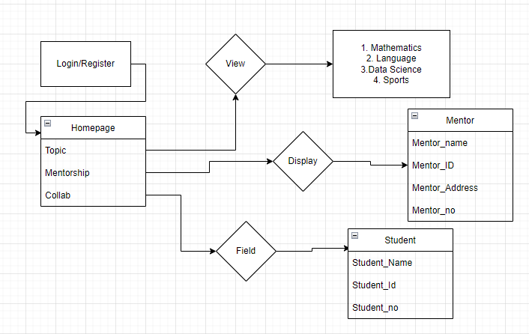
Flowchart :

Slide 9
Ideas for Further implementation :
We can create one more section for viewing the published papers , so as to get ideas for the users who want to write papers in that field
We can rate the published papers by putting a like button . In this way, the user who wants to read the research paper would be able to know which paper is the best

